Slide 1
Curriculum sensitivity of the TIMSS science test: Adjacent-grades within schools design
Stephan Daus NIFU / CEMO, UiO
Agnes Stancel-Piątak IEA Hamburg
Johan Braeken CEMO, UiO

Slide 2
Background
Intro
Design
Results
Discussion
“TIMSS studies the effectiveness of curriculum and instruction in relation to student achievement […]” (Mullis & Martin, 2005, p. 13)
If TIMSS is to be of maximum use to a country’s educators, TIMSS should be linked to the curriculum being analysed.
Insufficient to accept such an assumption; should be verified.
Curriculum sensitivity is one approach for verifying this link.

Slide 3
Intro
Design
Results
Discussion
Limitations in prior research:
lack of control for prior achievement
lack of a control for a cohort effect
lack of fine-grained analyses
Scope of this study:
  Item-specific and test-generic evidence of curriculum sensitivity in TIMSS 2015 to Norwegian science teachers’ instruction in grades 8 and 9, while controlling for a cohort effect.

Slide 4
Conceptual Approach
Intro
Design
Results
Discussion
Easiness
Easiness
Easiness
Entire test
Electricity item
(taught upper grade)
Astronomy item
(taught lower grade)
Pos. DIF
Cohort
effect
Neg. DIF
Lower
grade
Upper
grade
Lower
grade
Upper
grade
Lower
grade
Upper
grade

Slide 5



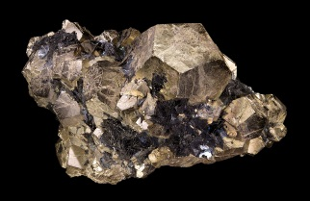




Intro
Design
Results
Discussion
Trends in International Mathematics and Science Study 2015 – science part
Intact classes within random sample of Norwegian schools.
Both cohorts within same school.
Domains
Biology
Chemistry
Earth Science
Physics
Sample size | Grade 8 | Grade 9
Students | 4,774 | 4,673
Schools | 142
Items | 198
Topics | 18
Responses | 267,130
Topics
Chemical Changes
Composition of Matter
Properties of Matter

Slide 6
Three modelling steps
Intro
Design
Results
Discussion
Identify cohort effect (difference across grades in achievement mean).
Explore items that differ from the cohort effect (~Differential Item Functioning).
  Post-hoc explanation with population-aggregated content coverage patterns.
Explain overall test’s sensitivity to school-specific content coverage patterns.
TECHNICAL DETAILS
Based on 1PL/Rasch model (uniform DTF). Framework: generalized linear mixed modelling
Software: lme4-package in R

Slide 7
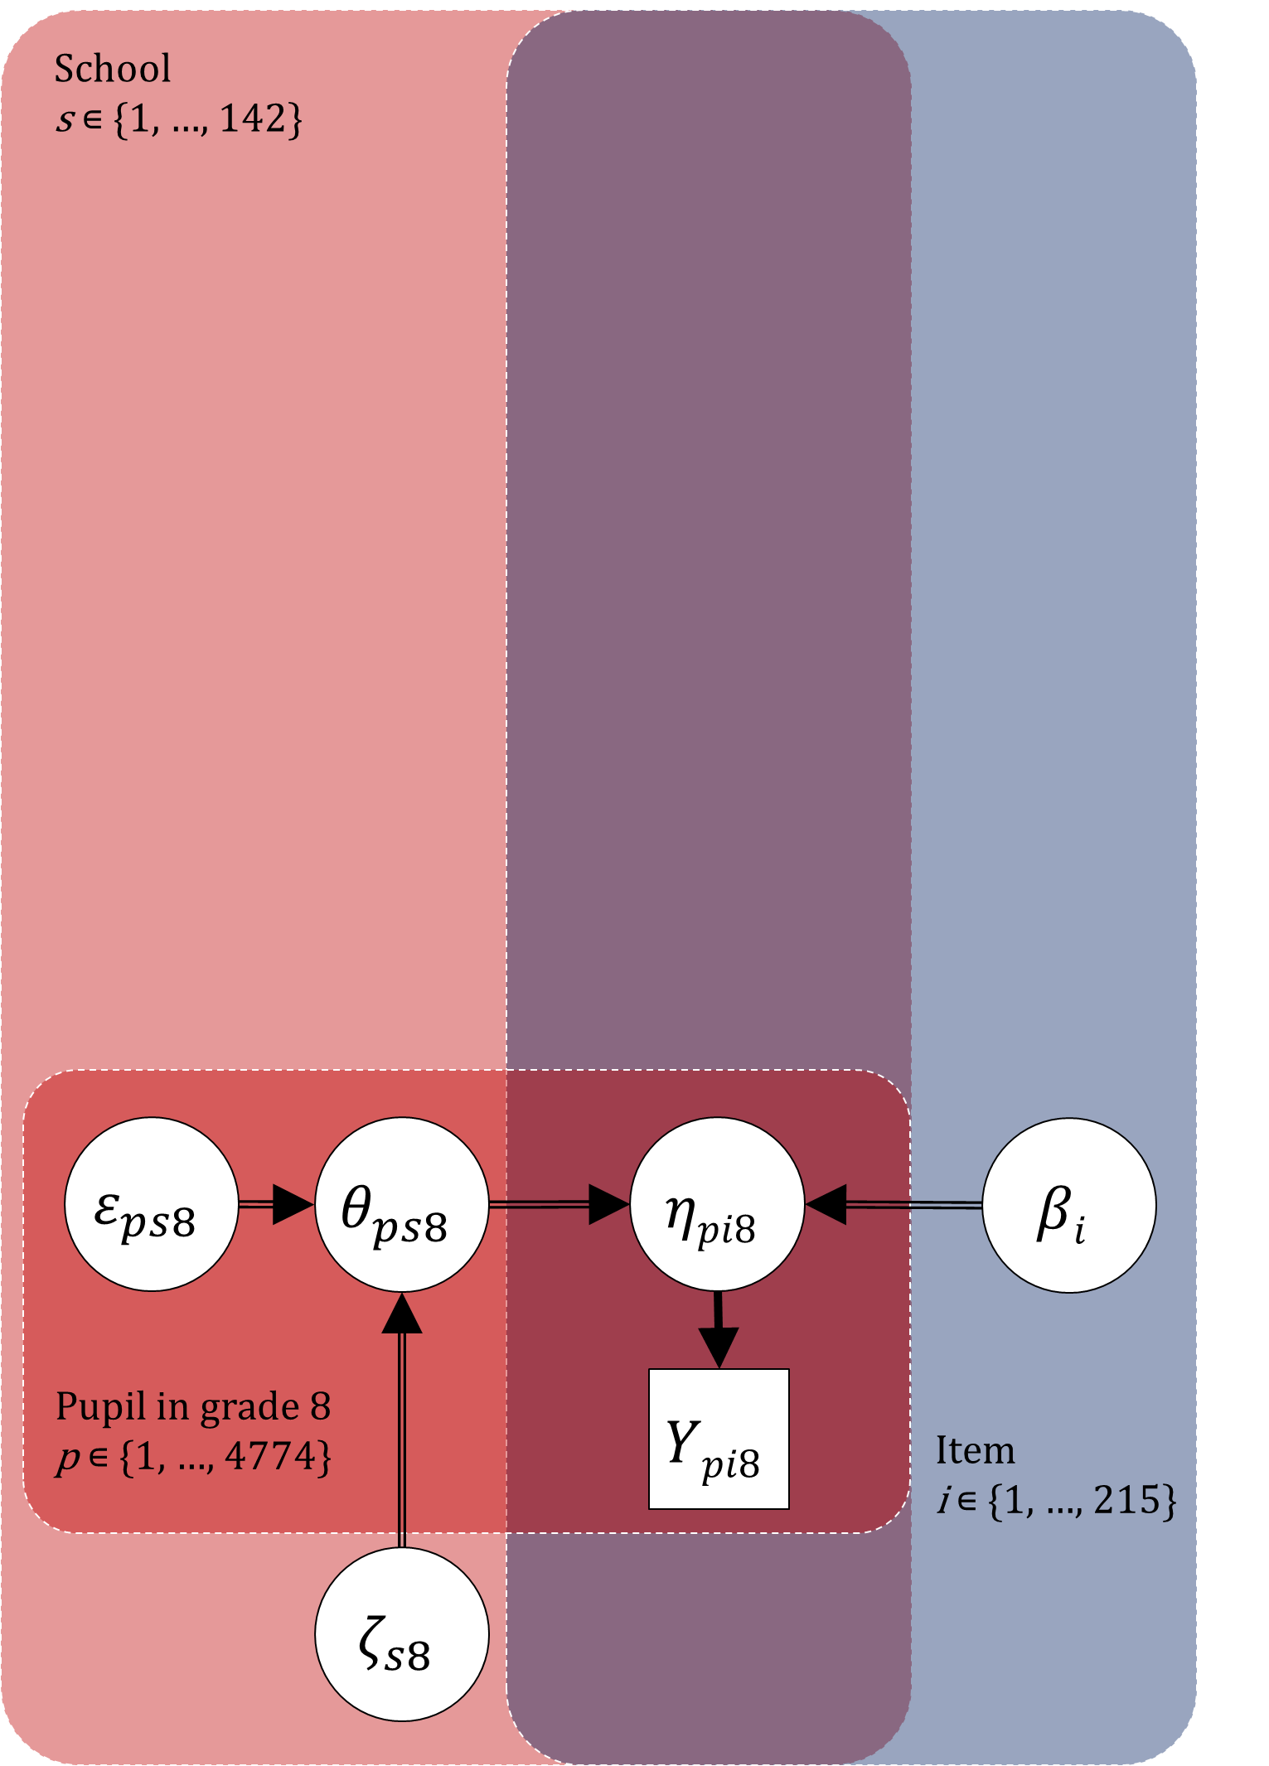
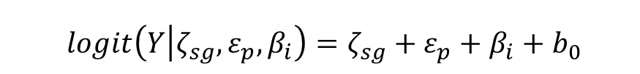
Intro
Design
Results
Discussion
(Building up model)
$$logit\left(Y | ζ_{sg},ε_{p},β_{i}\right)=ζ_{sg}+ε_{p}+β_{i}+b_{0}$$

Slide 8
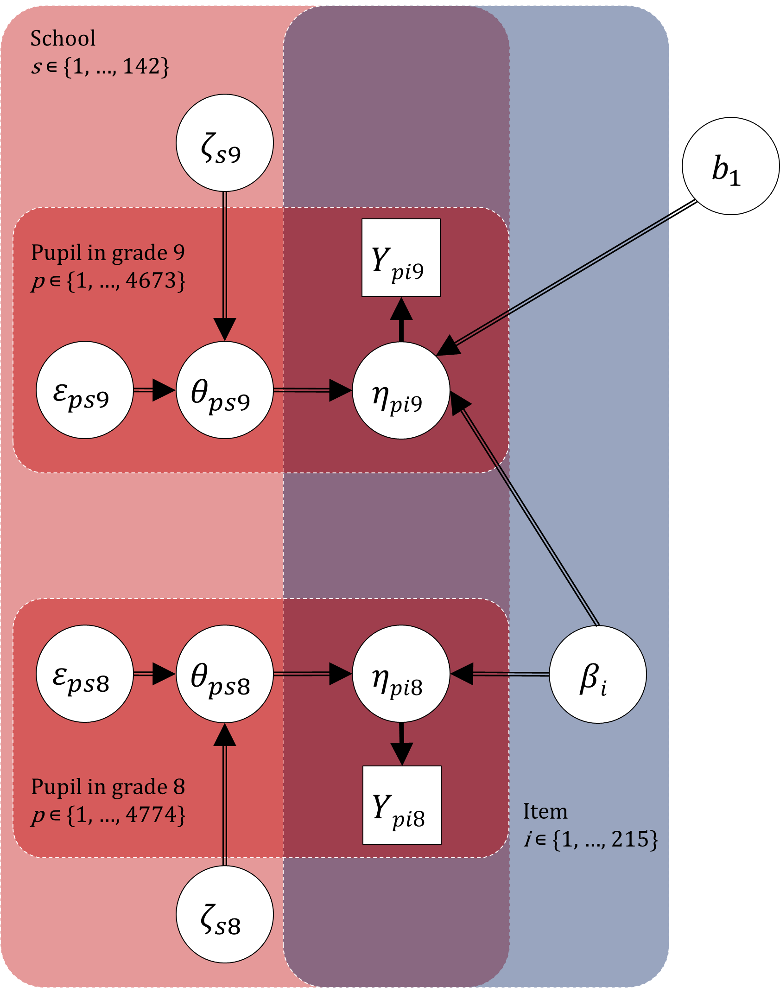
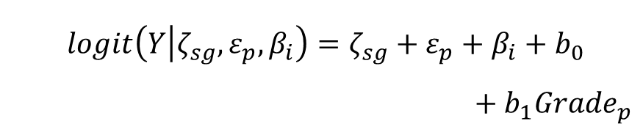
Intro
Design
Results
Discussion
(Building up model)
$$logit\left(Y | ζ_{sg},ε_{p},β_{i}\right)=ζ_{sg}+ε_{p}+β_{i}+b_{0}$$
$$+ b_{1}{Grade}_{p}$$

Slide 9
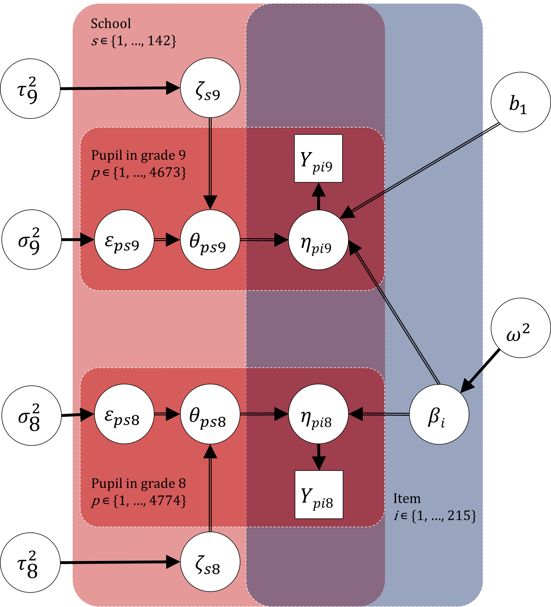
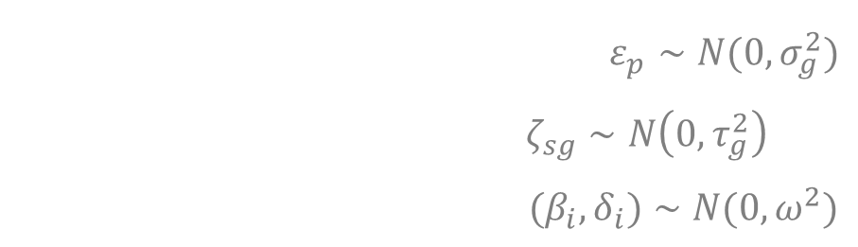
Model 1
Intro
Design
Results
Discussion
Identifying difference in achievement mean across grades
$$logit\left(Y | ζ_{sg},ε_{p},β_{i}\right)=ζ_{sg}+ε_{p}+β_{i}+b_{0}$$
$$+ b_{1}{Grade}_{p}$$
$ε_{p}∼N(0,σ_{g}^{2})$
$$ζ_{sg}∼N\left(0,τ_{g}^{2}\right)$$
$${(β}_{i},δ_{i})∼N(0,ω^{2})$$

Slide 10
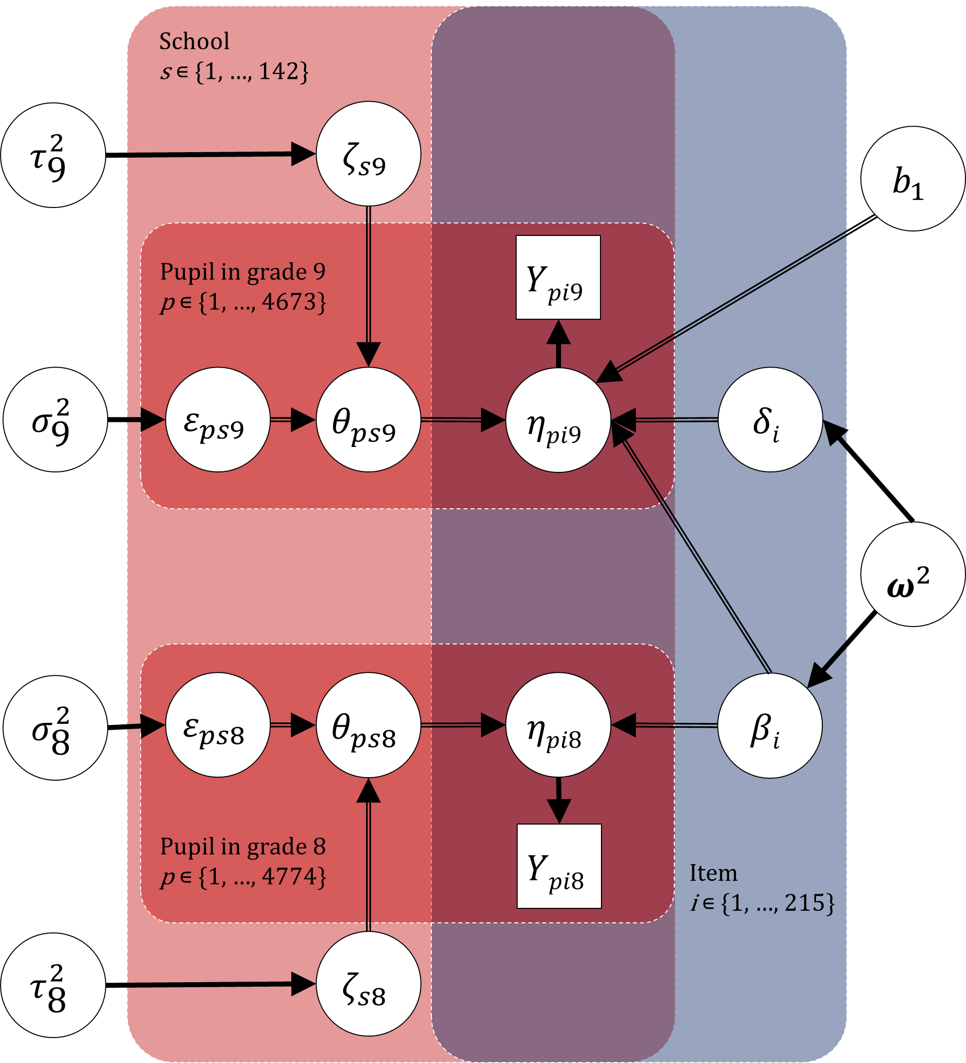
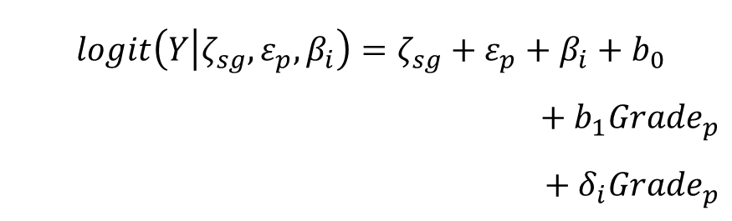
Model 2
Intro
Design
Results
Discussion
DIF across grades with post-hoc explanation using population-aggregated content coverage patterns
$$logit\left(Y | ζ_{sg},ε_{p},β_{i}\right)=ζ_{sg}+ε_{p}+β_{i}+b_{0}$$
$$+ b_{1}{Grade}_{p}$$
$$+ δ_{i}{Grade}_{p}$$
$ε_{p}∼N(0,σ_{g}^{2})$
$$ζ_{sg}∼N\left(0,τ_{g}^{2}\right)$$
$${(β}_{i},δ_{i})∼N(0,ω^{2})$$

Slide 11
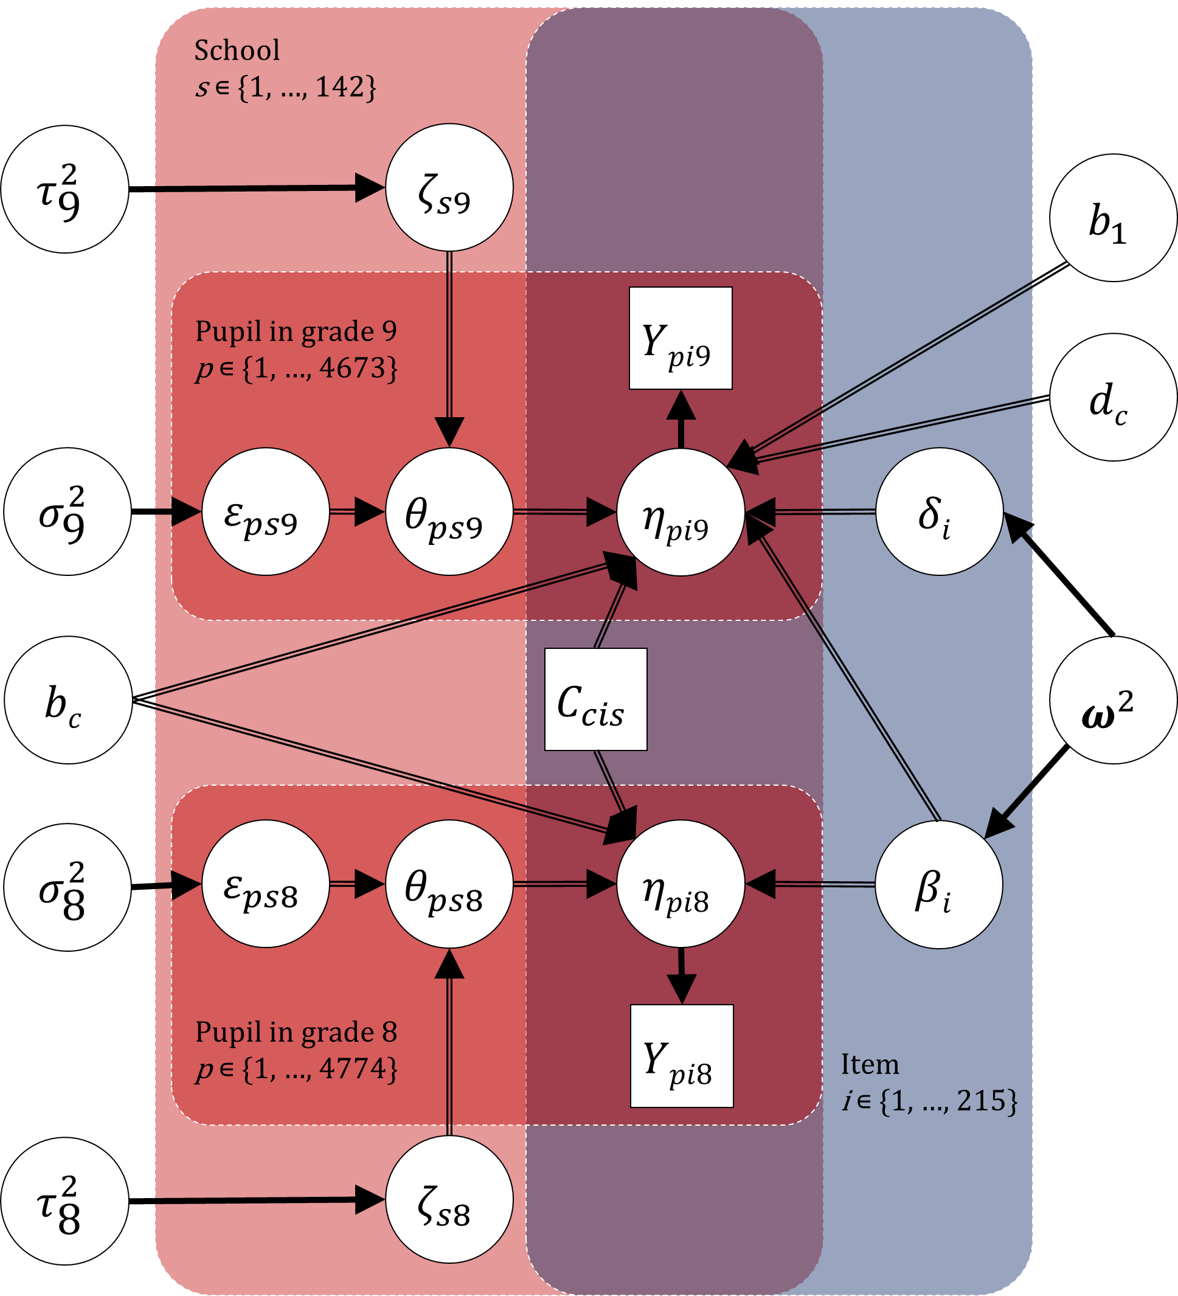
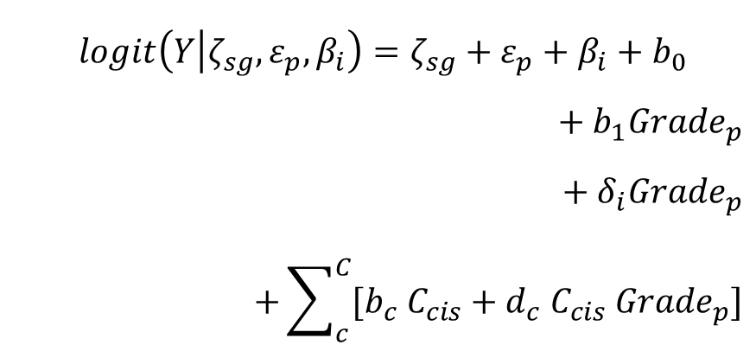
Model 3
Intro
Design
Results
Discussion
Using school-specific content coverage to explain probability of correct response
$$logit\left(Y | ζ_{sg},ε_{p},β_{i}\right)=ζ_{sg}+ε_{p}+β_{i}+b_{0}$$
$$+ b_{1}{Grade}_{p}$$
$$+ δ_{i}{Grade}_{p}$$
$$+\sum_{c}^{C}{{[b}_{c} C_{cis}+d_{c} C_{cis} {Grade}_{p}]}$$
$ε_{p}∼N(0,σ_{g}^{2})$
$$ζ_{sg}∼N\left(0,τ_{g}^{2}\right)$$
$${(β}_{i},δ_{i})∼N(0,ω^{2})$$

Slide 12
Coding Scheme for Content Coverage Patterns from Teacher Responses
Intro
Design
Results
Discussion
Teacher response on content coverage |  | Categories of the school-specific content coverage pattern (C_{cis}) |  |  |  |  |  |  | Teacher response (in %)
 |  | Before grade 8 | In grade 8 | In grade 9 | In grades 8 & 9 | Above grade 9 | <unclear> | <missing>
Grade 8 teacher coverage response | Earlier | X |  |  |  |  |  |  | 5.8
 | This year |  | X |  | X |  |  |  | 24.6
 | Not yet |  |  | X |  | X |  |  | 45.1
 | Missing |  |  |  |  |  |  |  | 24.5
Grade 9 teacher coverage response | Earlier | X | X |  |  |  |  |  | 27.0
 | This year |  |  | X | X |  |  |  | 19.6
 | Not yet |  |  |  |  | X |  |  | 27.8
 | Missing |  |  |  |  |  |  |  | 25.6
Schools (in %) having content coverage pattern |  | 3.9 | 13.5 | 10.4 | 5.9 | 21.1 | 27.9 | 17.2 | 100.0

Slide 13
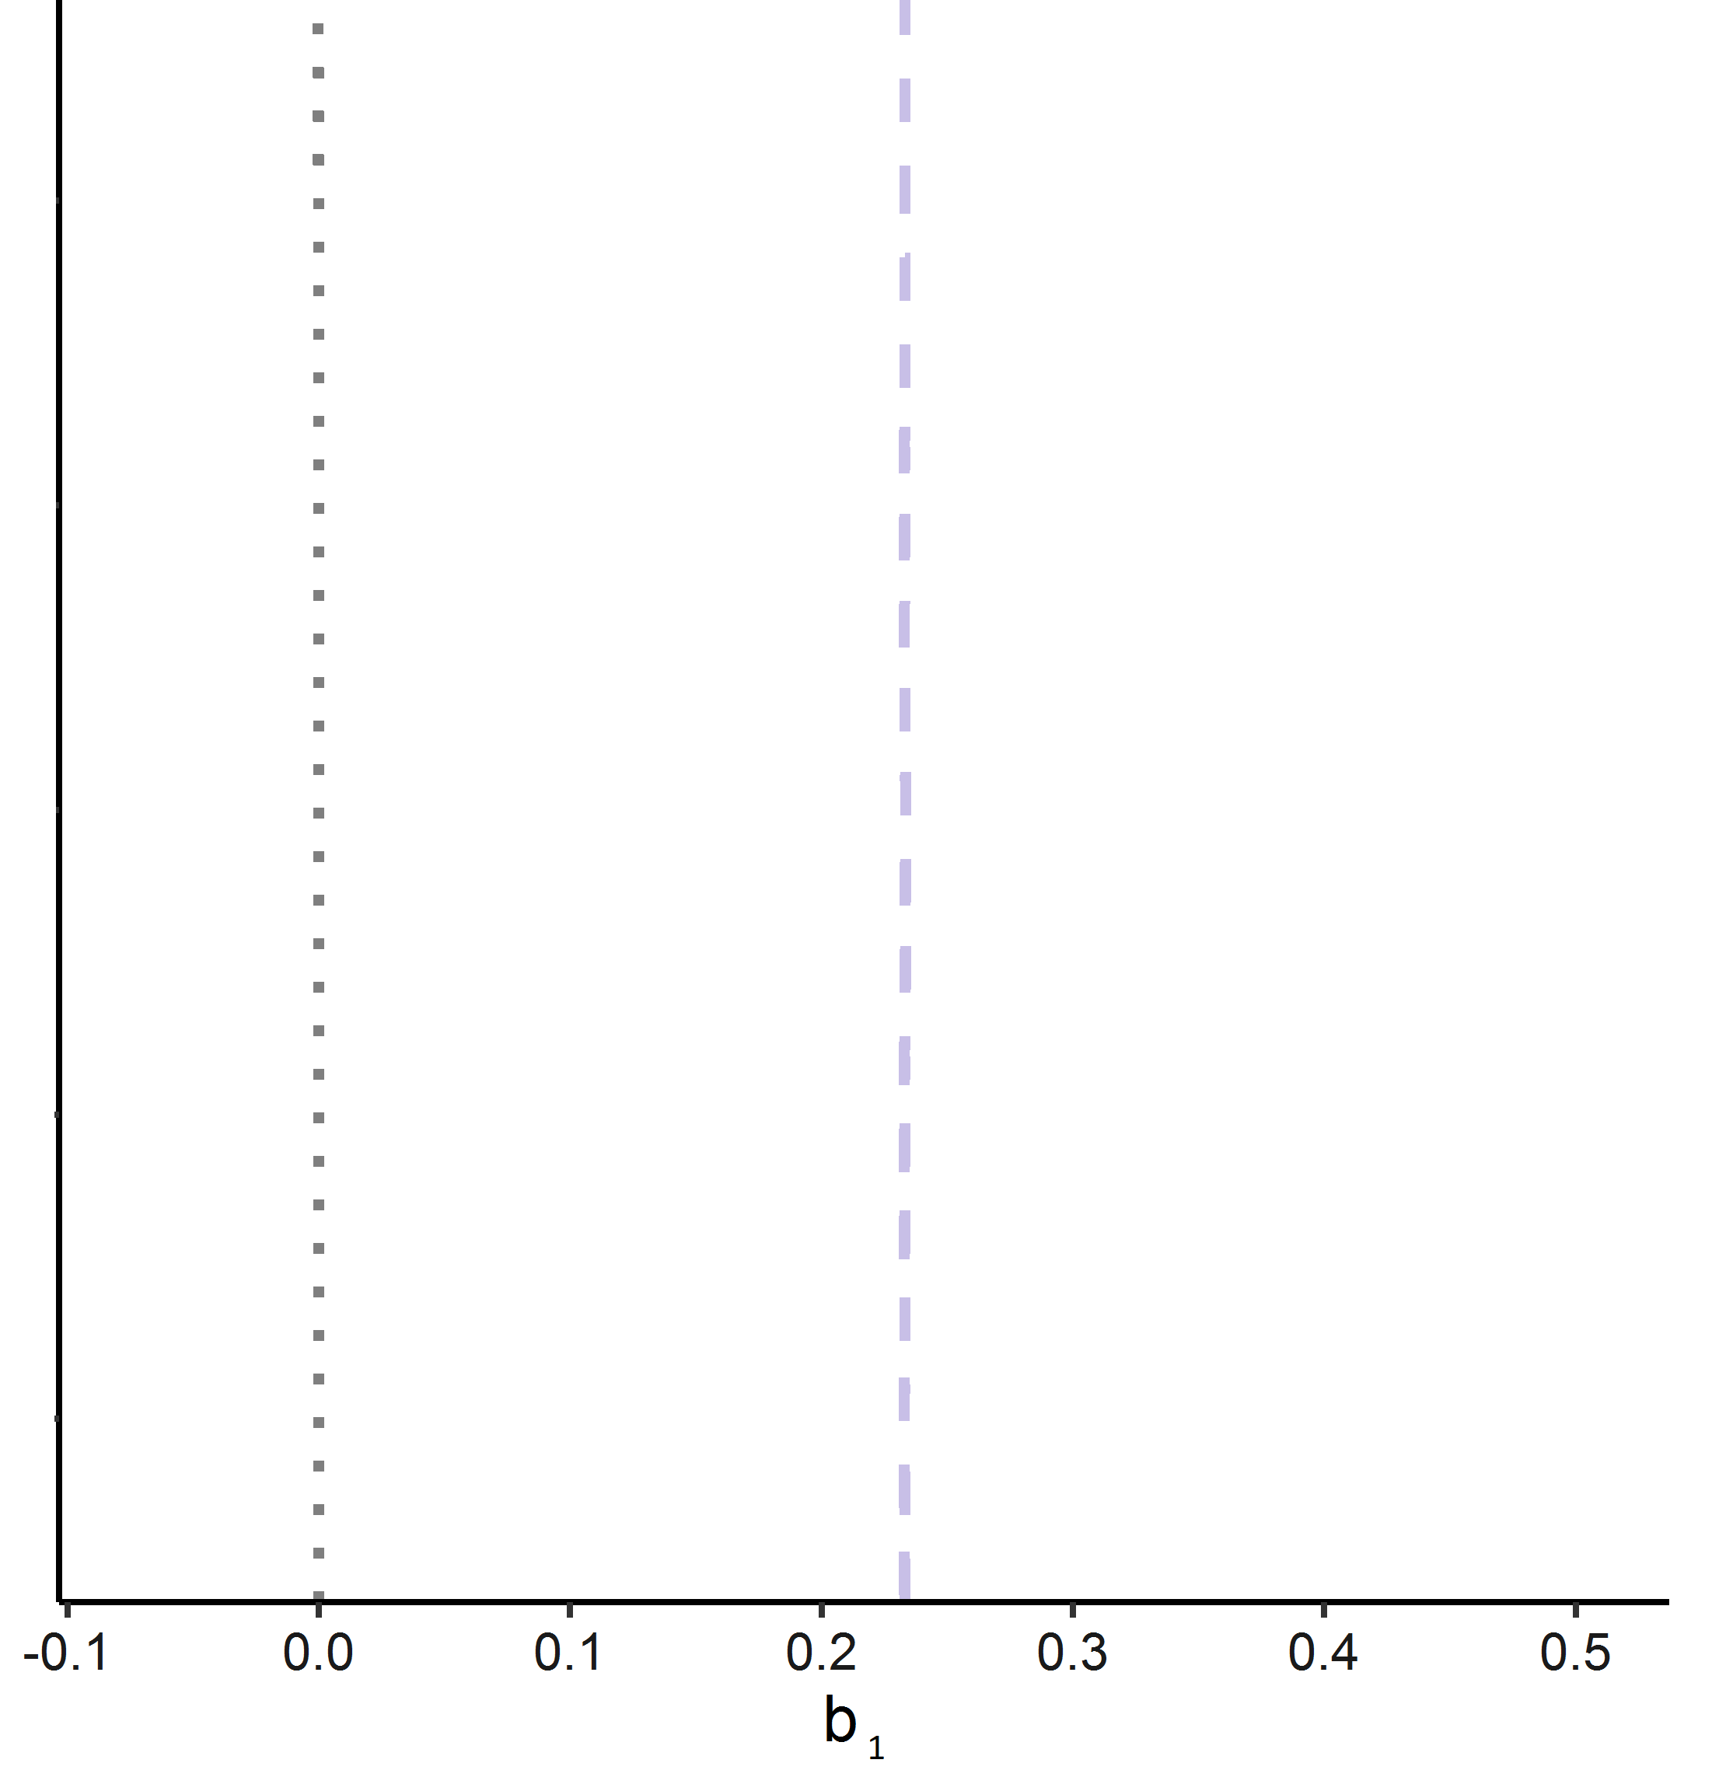
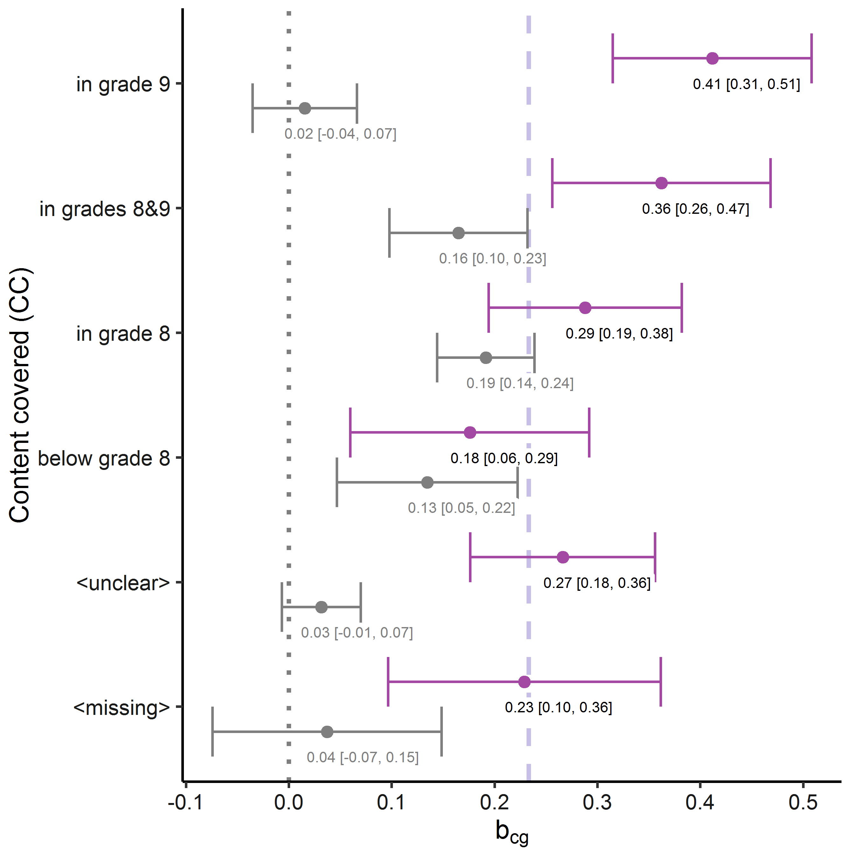
Model 1 –
Difference in mean achievement
Intro
Design
Results
Discussion
Compared with grade 8 ( ), higher item correct
probability in grade 9 ( ).
  46% vs 51% on an average item/person

Slide 14
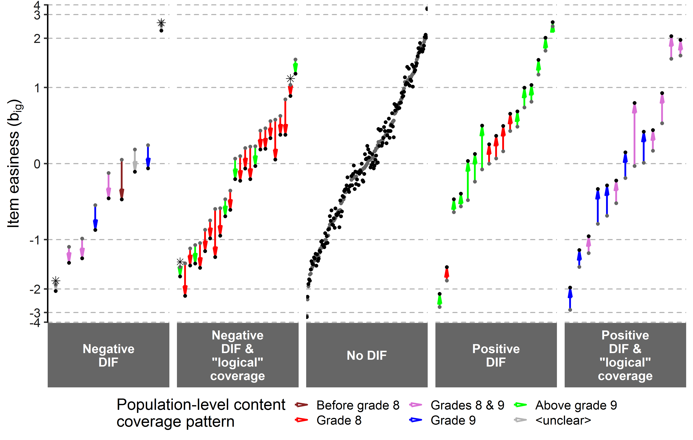

Model 2 – items
Intro
Design
Results
Discussion
($δ_{i})$
5%
10%
71%
8%
6%

Slide 15
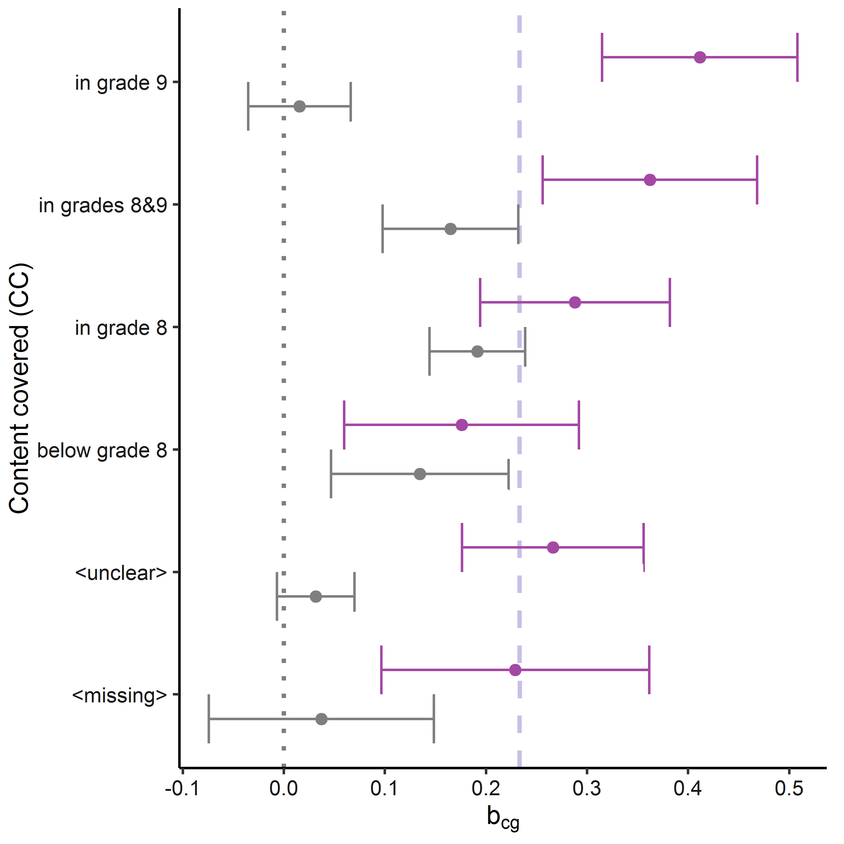
Model 3 – Overall test
Intro
Design
Results
Discussion
School-level content coverage patterns explain item response probability within grade 8 ( )
and grade 9 ( ).
Effect of coverage similar to a year of schooling.
Patterns are «logical».
(C)

Slide 16

Limitations
Intro
Design
Results
Discussion
Tricky linking between topics in indicators for content coverage & test.
17% missingness in coverage patterns.
Inferences limited to specific (Norwegian) population.

Slide 17
Take home messages
Intro
Design
Results
Discussion
Sensitivity of TIMSS science items to Norwegian curriculum
  16% of science items are clearly sensitive; 71% are sensitive to cognitive development/maturation and/or curriculum
  Content coverage contributes to achievement similarly to a year of schooling
➔ TIMSS somewhat sensitive to Norwegian curriculum
  “New” issue: Sensitivity balance across countries?
Fine-grained, adjacent-cohorts within-schools design allows “robust” curriculum sensitivity analyses
  Design increases precision and accuracy
  Yet limitations present
Stephan Daus
stephan.daus@nifu.no

Slide 18

Rebuttals
Intro
Design
Results
Discussion
MH limited:
  Zero cells in the crosstables
  Trickier for topic-level DTF
Why use population-level patterns in DIF-analysis (M2)?
  No easy way to connect the $δ_{i}$ with $C_{cis}$.

